Slide 1





Superstore Dataset
Insight Squad Sales Evolution
Abdullah Ashraf Hessien
Fares Mohamed Mostafa
Mohamed Aly Laskar
Mohamed Bahaa Mohamed
Yahia Ahmed Elsayed

Slide 2
Main problem trying to solve

Slide 3
Sales performance is inconsistent across regions, customers, and ship modes. causing lost revenue and reduced profitability.
Kpis to focus on to analysis this metric
Total Sales
Total Profit
Profit Margin
Total Quantity Sold
Average Discount %
Profit by Region
Sales by State
Average Order Value (AOV)
Customer Lifetime Value (CLV)
Top Customers
These all point to identifying where the business is winning vs. losing
We analyzed the data to understand which regions, customers, and products drive or drain revenue and to uncover actionable patterns to fix inconsistent sales performance
To understand which areas of the business drive or weaken revenue and profitability.

Slide 4
Delivery times and shipping methods are affecting customer satisfaction and profitability.
Kpis to focus on to analysis this metric
Average Delivery Time (Overall)
Average Delivery Time per Ship Mode
Average Delivery Time by Month
Ship Mode Summary – Overall
Ship Mode Performance by Region
Ship Mode Share of Total Sales (%)
We analyzed the data to reveal delivery inefficiencies across ship modes and regions — and to understand how these delays impact customer satisfaction and profit.
To identify bottlenecks and inefficiencies in shipping and delivery performance across regions and ship modes.

Slide 5
About Our Data
Data Source
Dataset sourced from Kaggle, a trusted platform for open real-world data.
Data Size
Contains ≈ 10,000 rows and 21 columns, offering a comprehensive view of sales transactions.

Slide 6
Data Structure and Columns
Categorical
Numerical
Date/Time
Unique Identifiers (IDs)
Ship Mode
Customer Name
Segment
Country
City
State
Postal Code
Region
Category
Sub-Category
Product Name
Sales
Profit
Quantity
Discount
Order Date
Ship Date
Row ID
Order ID
Customer ID
Product ID

Slide 7


python
Handling Missing Values
Checked df.info() and df.describe() → all columns have no missing values.
No imputation was needed as the dataset is complete.
Handling Duplicates
Checked for duplicates df.duplicated().sum())
if there were duplicates
df.drop_duplicates(inplace=True)

Slide 8
python
Formating
Converted Order Date and Ship Date to datetime format (for analysis by month/year):
Ensured numerical columns (Sales, Profit, Quantity, Discount) are correctly typed (float or int)
df['Order Date'] = pd.to_datetime(df['Order Date'])
df['Ship Date'] = pd.to_datetime(df['Ship Date'])

Slide 9
encoding
Categorical columns (Ship Mode, Segment, Region, Category, Sub-Category) are stored as object (string) type.
If needed for modeling: applied Label Encoding or One-Hot Encoding:
df = pd.get_dummies(df, columns=['Ship Mode', 'Category'])

Slide 10
5. Other Preprocessing
Checked for negative values (Profit) → important for analysis.Cleaned column names (removed spaces, standardized naming):
df.columns = df.columns.str.strip().str.replace(' ', '_')

Slide 11
Missing Values: Checked all columns, no missing values found.
Encoding: Prepared categorical columns for analysis and modeling.
Other Preprocessing: Cleaned column names and verified profit values for accuracy.
Duplicates: Examined dataset, no duplicate rows detected.
Formatting: Converted dates to datetime and ensured numerical columns have correct types.

Slide 12


SQL Analysis (KPIs + Descriptive Analytics)
Total Sales
Total Profit
Profit Margin
Total Quantity Sold
Regional Performance
Profit By region
Sales By state
Average Delivery time Overall
Average Delivery time per ship mode
Average Delivery time by month
Ship mode summary
Ship mode performance by region
Ship mode share of total sales
Customer
Average order value (AOV)
Customer Lifetime value (CLV)
Top customers

Slide 13
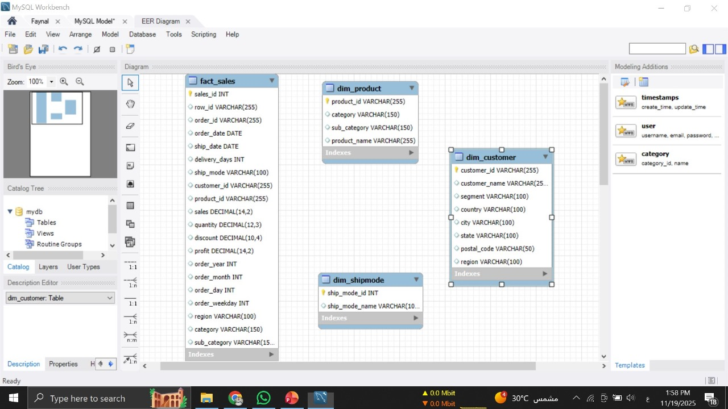
Overview of the Database Entities and Relationships
(Based on SQL Schema)

Slide 14
Overview Page
1. Total Sales, Total Profit & Profit Margin
Description:
These metrics provide a high-level view of the company’s financial performance, indicating how effectively revenue is being converted into profit.
Insight:
A healthy profit margin reflects efficient operations and strong pricing strategy.

Slide 15
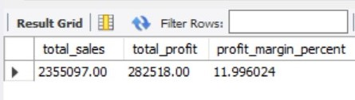
SELECT
SUM(sales) AS total_sales,
SUM(profit) AS total_profit,
(SUM(profit) / SUM(sales)* 100) AS profit_margin_percent
FROM fact_sales;

Slide 16
2. Total Quantity Sold
Description:
Represents the total number of product units sold across all orders.
Insight:
A strong indicator of product demand regardless of price variations.

Slide 17
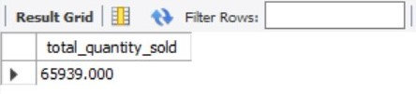
SELECT
SUM(quantity) AS total_quantity_sold
FROM fact_sales;

Slide 18
3. Average Discount
Description:
The mean discount applied across all transactions.
Insight:
Helps assess reliance on discounting strategies and their potential impact on profitability.

Slide 19
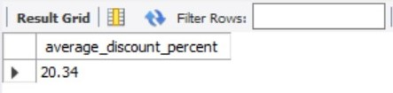
SELECT round(AVG(discount)*100,2) AS average_discount_percent
FROM fact_sales;

Slide 20
REGIONAL PERFORMANCE
4. Profit by Region
Description:
Evaluates how each geographic region contributes to total profit.
Insight:
Highlights high-performing regions that should be prioritized and low-performing areas that may require operational review.

Slide 21
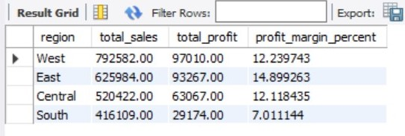
SELECT c.region,
SUM(f.sales) AS total_sales,
SUM(f.profit) AS total_profit,
(SUM(f.profit) / SUM(f.sales) * 100) AS profit_margin_percent
FROM fact_sales f
JOIN dim_customer c USING(customer_id)
GROUP BY c.region
ORDER BY total_sales DESC;

Slide 22
5. Sales by State
Description:
Breaks down total revenue at the state level to identify key markets.
Insight:
Top-selling states often represent the strongest opportunities for expansion and targeted marketing.

Slide 23
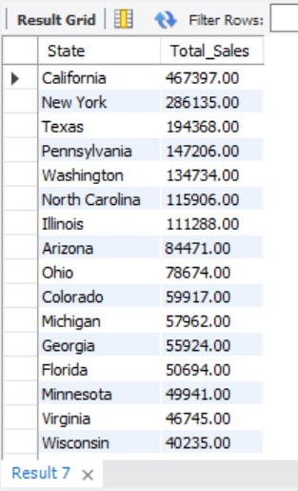
SELECT c.state AS State,
SUM(f.sales) AS Total_Sales
FROM fact_sales f
JOIN dim_customer c USING (customer_id)
GROUP BY c.state
ORDER BY total_sales DESC;

Slide 24
CUSTOMER ANALYTICS
6. Average Order Value (AOV)
Description:
Measures the average revenue generated per order.
Formula: Total Sales ÷ Number of Orders
Insight:
Higher AOV indicates customers are purchasing
higher value items or larger baskets.

Slide 25
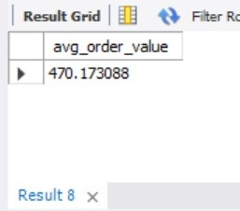
SELECT
SUM(sales) / COUNT(DISTINCT order_id) AS avg_order_value
FROM fact_sales;

Slide 26
7. Customer Lifetime Value (CLV)
Description:
Represents the total revenue generated by a customer throughout the dataset period.
Insight:
Essential for identifying loyal, high-value customers worth retaining through personalized engagement.

Slide 27
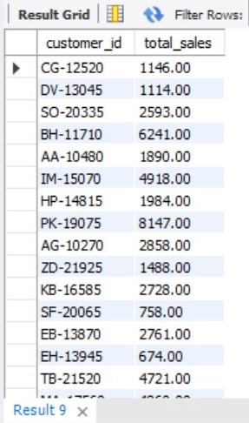
SELECT customer_id,
SUM(sales) AS total_sales
FROM fact_sales
GROUP BY customer_id;

Slide 28
8. Top Customers
Description:
Highlights customers with the highest spending.
Insight:
These individuals drive a significant share of revenue and should be prioritized for loyalty programs and premium services.

Slide 29
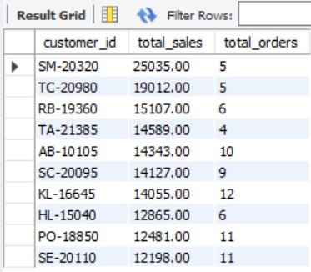
SELECT customer_id,
SUM(sales) AS total_sales,
COUNT(DISTINCT order_id) AS total_orders
FROM fact_sales
GROUP BY customer_id
ORDER BY total_sales DESC
LIMIT 10;

Slide 30
OPERATIONAL INSIGHTS
9. Average Delivery Time (Overall)
Description:
The average number of days taken to ship an order after it’s placed.
Insight:
Reflects operational efficiency and directly influences customer satisfaction.

Slide 31
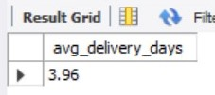
SELECT
ROUND(AVG(delivery_days), 2) AS avg_delivery_days
FROM fact_sales;

Slide 32
10. Average Delivery Time per Ship Mode
Description:
Compares delivery speed across shipping modes (Standard, Second Class, First Class, Same Day).
Insight:
Identifies the most efficient shipping methods and those that may require optimization.

Slide 33
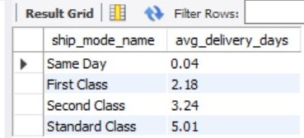
SELECT s.ship_mode_name,
ROUND(AVG(f.delivery_days), 2) AS avg_delivery_days
FROM fact_sales f
JOIN dim_shipmode s
ON f.ship_mode = s.ship_mode_name
GROUP BY s.ship_mode_name
ORDER BY avg_delivery_days;

Slide 34
11. Average Delivery Time by Month
Description:
Tracks how delivery performance changes throughout the year.
Insight:
Useful for identifying seasonal delays or peak-pressure periods in logistics.

Slide 35
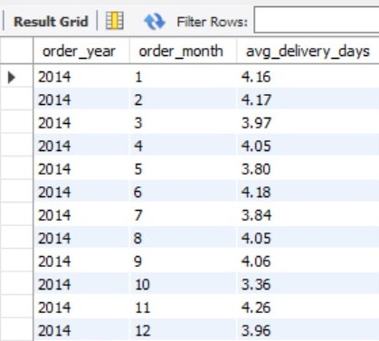
SELECT order_year, order_month,
ROUND(AVG(delivery_days), 2) AS avg_delivery_days
FROM fact_sales
GROUP BY order_year, order_month
ORDER BY order_year, order_month;

Slide 36
SHIP MODE PERFORMANCE
12. Ship Mode Summary
Description:
Provides a consolidated view of orders, sales, profit, and average delivery time for each shipping mode.
Insight:
Reveals whether the most frequently used shipping method is also the most profitable.

Slide 37
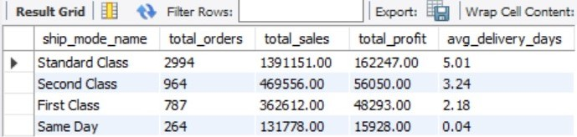
SELECT s.ship_mode_name,
COUNT(DISTINCT f.order_id) AS total_orders, ROUND(COALESCE(SUM(f.sales),0),2) AS total_sales, ROUND(COALESCE(SUM(f.profit),0),2) AS total_profit, ROUND(AVG(f.delivery_days),2) AS avg_delivery_days
FROM fact_sales f
JOIN dim_shipmode s ON f.ship_mode = s.ship_mode_name
GROUP BY s.ship_mode_name
ORDER BY total_sales DESC;

Slide 38
13. Ship Mode Performance by Region
Description:
Analyzes the effectiveness of each ship mode across different regions.
Insight:
Shows where specific shipping options are more successful and where adjustments may be needed.

Slide 39
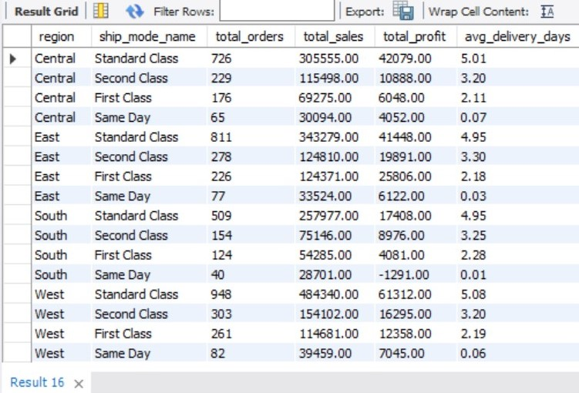
SELECT c.region, s.ship_mode_name,
COUNT(DISTINCT f.order_id) AS total_orders,
ROUND(COALESCE(SUM(f.sales),0),2) AS total_sales,
ROUND(COALESCE(SUM(f.profit),0),2) AS total_profit,
ROUND(AVG(f.delivery_days),2) AS avg_delivery_days
FROM fact_sales f
JOIN dim_customer c
ON f.customer_id = c.customer_id
JOIN dim_shipmode s
ON f.ship_mode = s.ship_mode_name
GROUP BY c.region, s.ship_mode_name
ORDER BY c.region, total_sales DESC;

Slide 40
14. Ship Mode Share of Total Sales (%)
Description:
Measures each shipping mode’s contribution to total revenue.
Insight:
Helps understand customer shipping preferences and how they impact overall sales distribution.

Slide 41
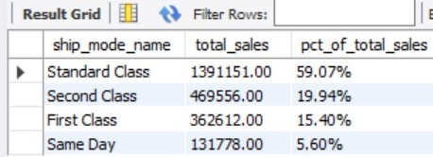
SELECT s.ship_mode_name,
ROUND(SUM(f.sales),2) AS total_sales,
CONCAT(ROUND(SUM(f.sales) * 100 / NULLIF((SELECT SUM(sales)
FROM fact_sales),0),2), '%') AS pct_of_total_sales
FROM fact_sales f
JOIN dim_shipmode s
ON f.ship_mode = s.ship_mode_name
GROUP BY s.ship_mode_name
ORDER BY total_sales DESC;

Slide 42

Visualization

Slide 43
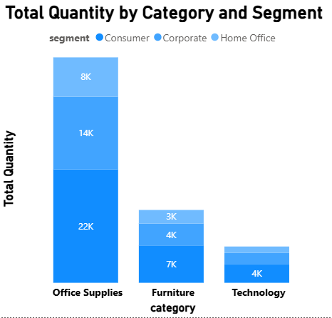
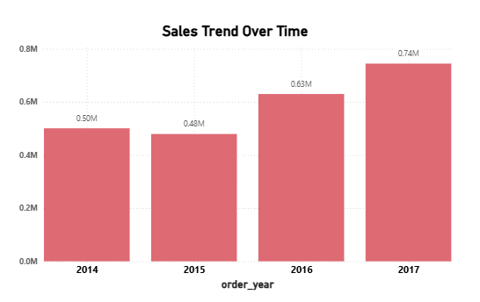
Company Growth and Key Categories
Office Supplies drives the majority of Quantity Sold
Steady Growth Over the Past 3 years
Largest jump in sales occurred between 2015 and 2016 marking a significant rebound after a slight dip
The business is consumer driven

Slide 44
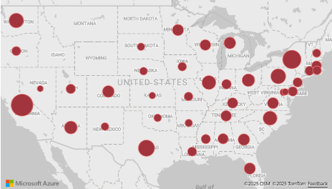
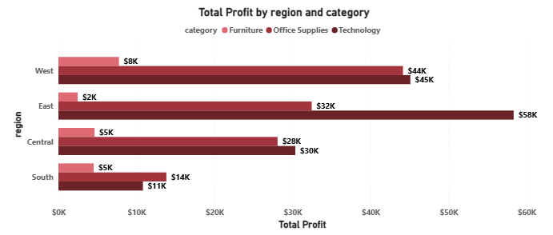
Profit Drivers Region and Product Contribution
sales and profit are heavily concentrated in
coastal and high-population states
The West generates nearly equal profit from both Office Supplies and Technology, indicating a well-diversified product mix.
The East region's high efficiency is driven by its dominant profit contribution from Technology
The South's low overall profit is due to low performance across all categories

Slide 45
Overview

Slide 46
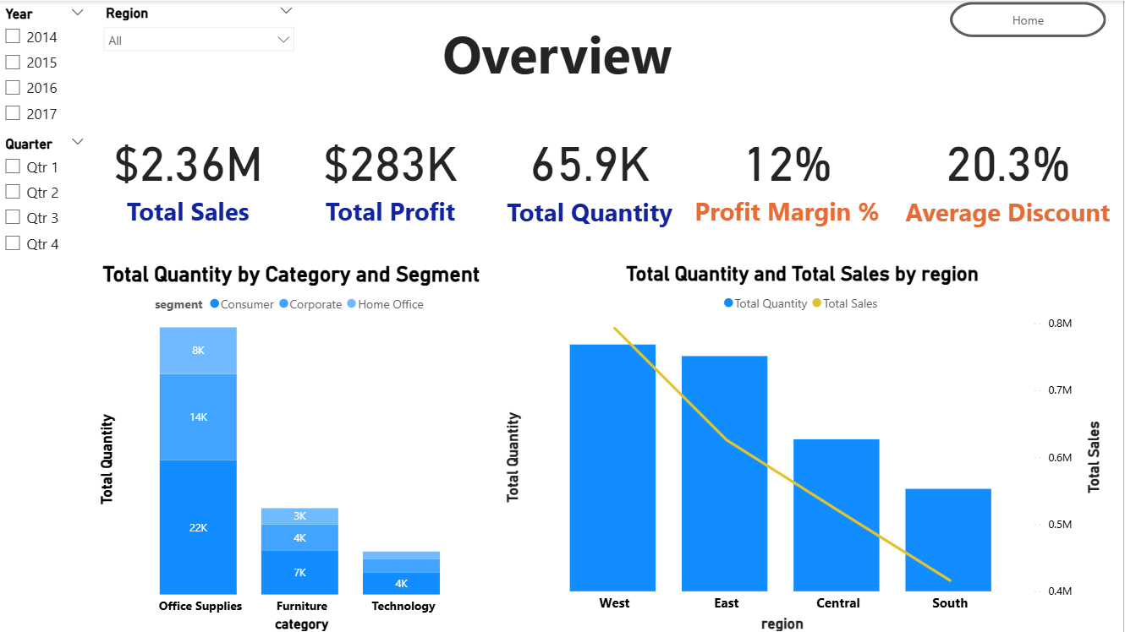

Slide 47
Identifying Product and Customer Drivers
Office Supplies (15%) drives the highest unit volume by far and contributes solid margin, making it the core revenue product.
Furniture (3%) is a losing product category. Its extremely low margin must be addressed immediately via pricing or discount reduction.
Technology (17%) has the highest margin and represents our greatest profit opportunity despite having the lowest sales volume.

Slide 48
Regional Performance

Slide 49
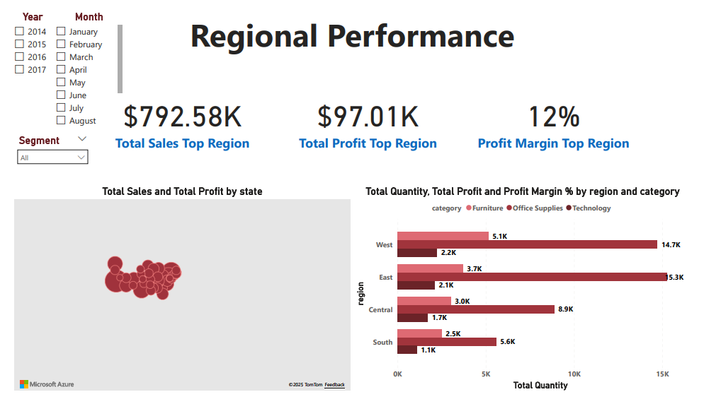
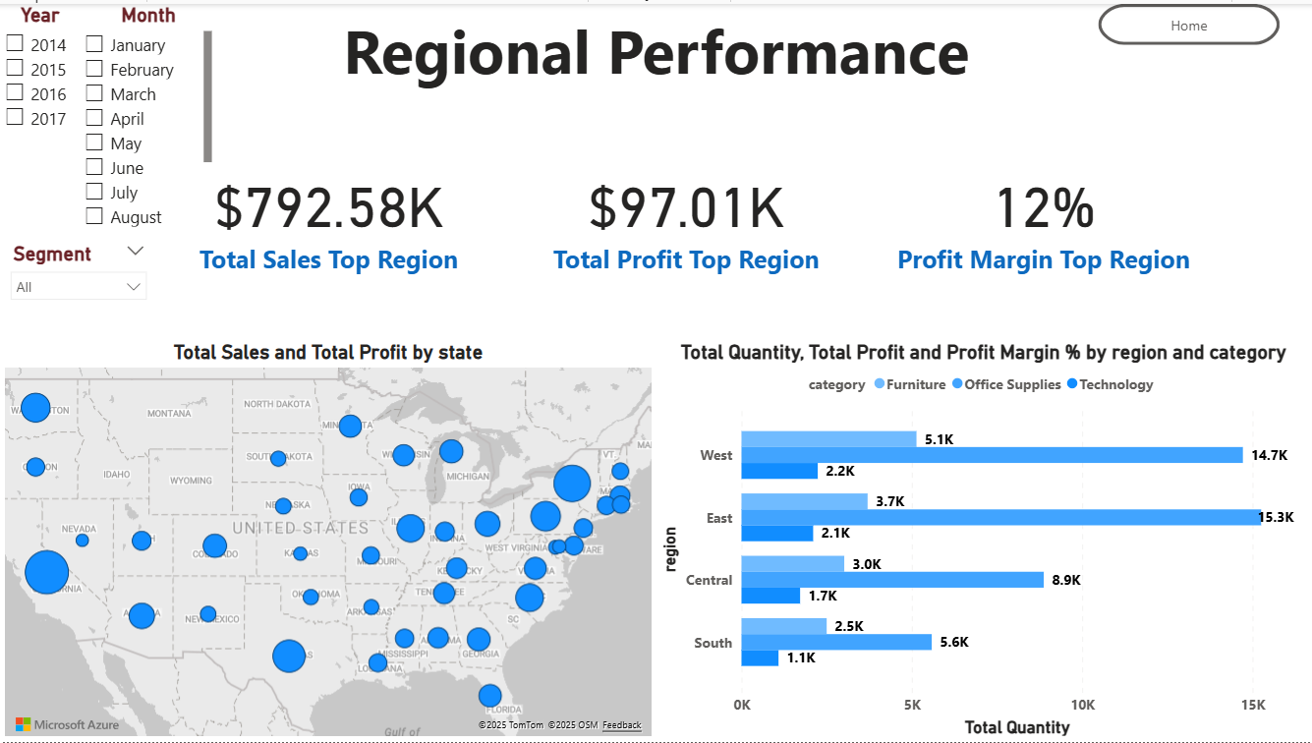

Slide 50
Regional Success: West as Sales Leader, East as Efficiency King
The West is the definitive top region
leading in Total Sales and Total Profit
The East is close behind in sales and profit
but generates a slightly higher overall Profit Margin
The South region struggles across the board
The Central region has low volume in Technology compared to the East and West.

Slide 51
Customer Analytics

Slide 52
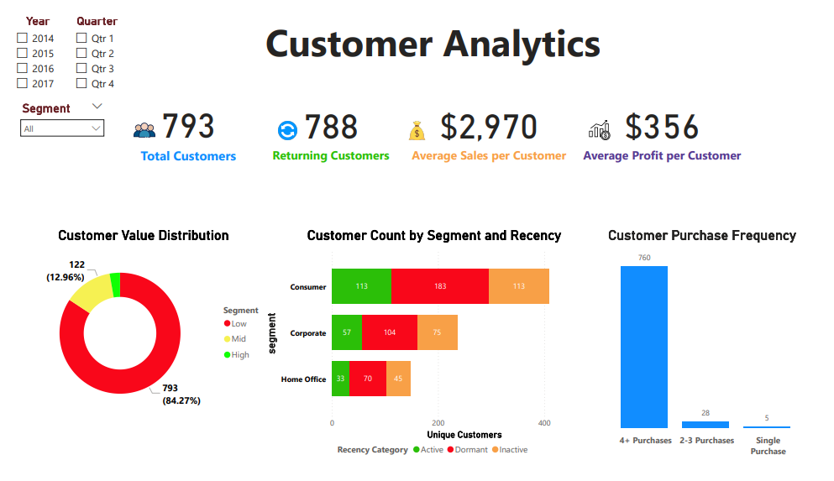
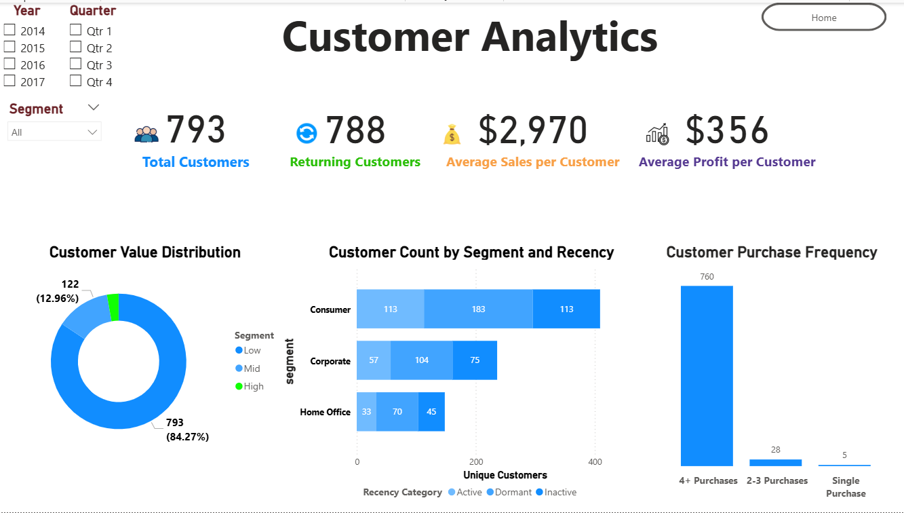

Slide 53
Shipping Performance

Slide 54
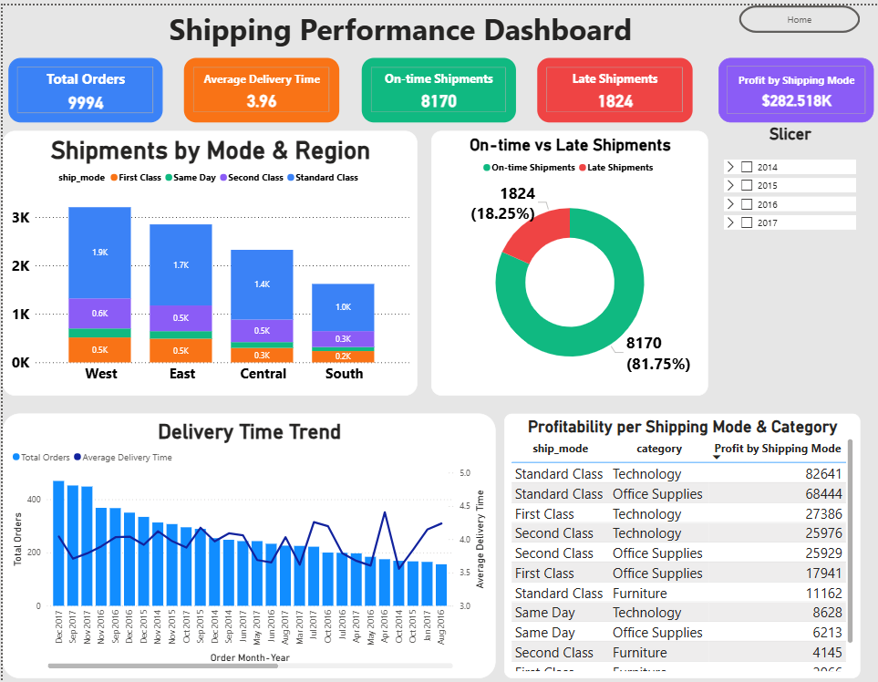

Slide 55
Seasonality and Customer Lifetime Value
Out of 793 Total Customers, an impressive 788 are Returning Customers. This indicates high customer loyalty.
Despite high retention, a large number of customers are Dormant or Inactive
this representing a massive churn risk.
Only 12.96% of your customer base is classified as High Value (122 customers). The vast majority (84.27%) fall into the Low or Mid-Value tiers.
The Average Profit per Customer is $356. The goal is to move more customers from the Low/Mid-Value tiers into the High-Value tier to significantly boost this average.
The high Average Sales per Customer ($2,970) suggests that when a customer does buy, they spend a significant amount. This indicates strong pricing power or large average order sizes, which is important to maintain

Slide 56
Recommendations & Strategy
Immediately review the cost to serve and pricing of Furniture (3% margin). Implement a plan to either increase its margin to a minimum of 8% or phase out non-profitable lines.
Increase the market share of Technology (17% margin) by leveraging its high profitability to fund aggressive marketing campaigns.
Ensure high stock levels and rapid fulfillment for Office Supplies (high volume, 15% margin) to maintain core revenue and prevent stock-outs.
Investigate the operational cost structure in the East region (highest overall margin) and apply those efficiency gains to Central and South regions.
Develop campaigns to push Technology sales directly to our Corporate and High-Value segments, particularly during the Q2/Q3 slump.

